Slide 1



Towards Machine-assisted Disclosure Assessment with DDI-CDI, DPV and sdcMicro
Deirdre Lungley, Principal Developer
Thomas Gilders, Data Engineer
Darren Bell, Associate Director, IT Services
Artiom Rumiancev, Data Engineer

Slide 2
Data Dissemination at the UKDA
SSRC Data Bank created
1967
450 studies
1975
Floppy disk service
1984
Tape/telnet
1993
6,000 studies
2007
Download service
2001
Prototyping the future
2022
3,000 studies

Slide 3
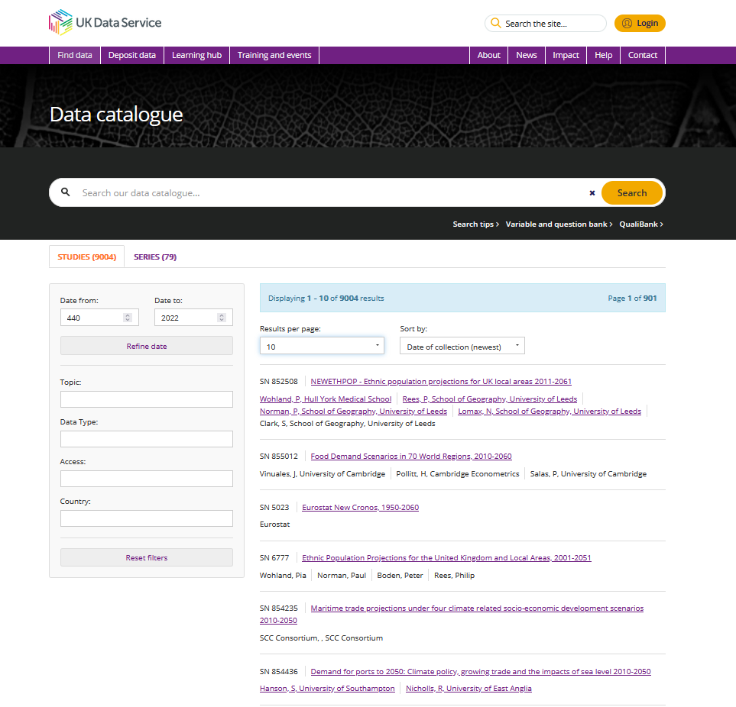

Slide 4
Data Dissemination in 2022
Challenges
Data is more complex, coming from more sources, and more quickly
Increased expectations from researchers for access turnaround times
Funders, industry and government increasingly interested in research which combines data from different arenas

Slide 5
Data Product Builder
What does it do?
Row and column sub setting, linkages, disclosure risk analysis
Aggregations, crosstabs

Slide 6
DPB Tool Powered by DDI-CDI (examples)
CDI Class | Class Association | Class Attribute | Function
ConceptualVariable | uses Concept |  | Enable dataset selection via semantic, geographical and temporal concepts
RepresentedVariable |  |  | Shared RepresentedVariables used for finding linkages between datasets
WideDataStructure | has MeasureComponent |  | Specify dataset filterable variables
RepresentedVariable | takesSubstantiveValuesFrom CodeList |  | Filter responses by category selection
ConceptualVariable | uses Concept |  | DPV concept - used to specify sensitive variables
InstanceVariable |  | variableFunction | Specify weight variable
ConceptualVariable | uses Concept |  | DPV concept - used to specify key variables to feed SDC analysis
Forward

Slide 7
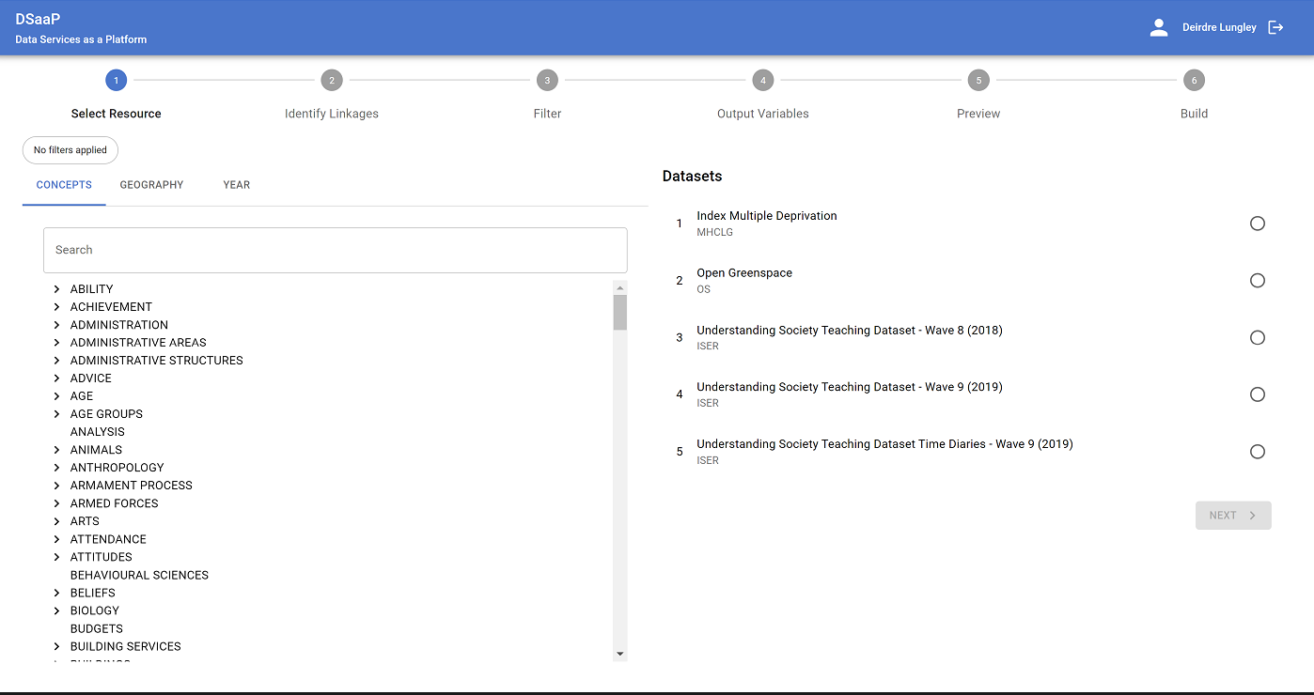
DPB – Dataset Selection
Back

Slide 8
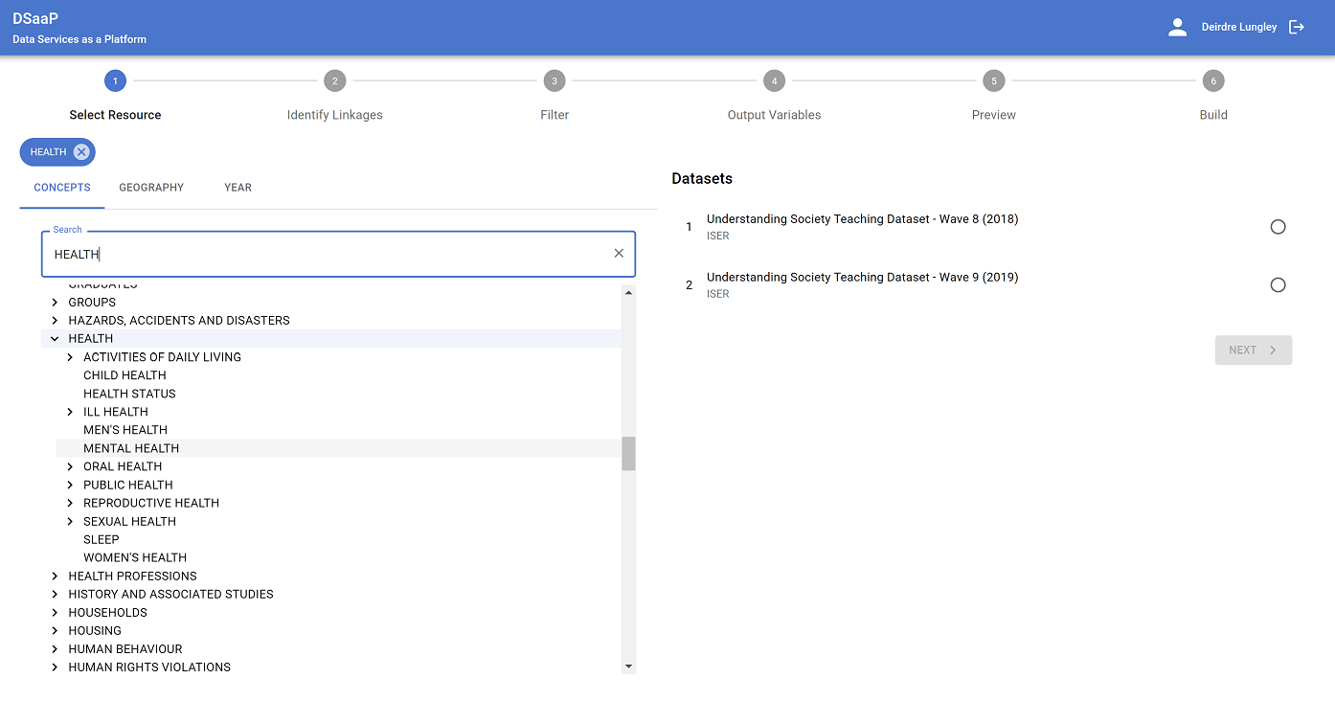
DPB – Dataset Selection (cont.)
Back

Slide 9
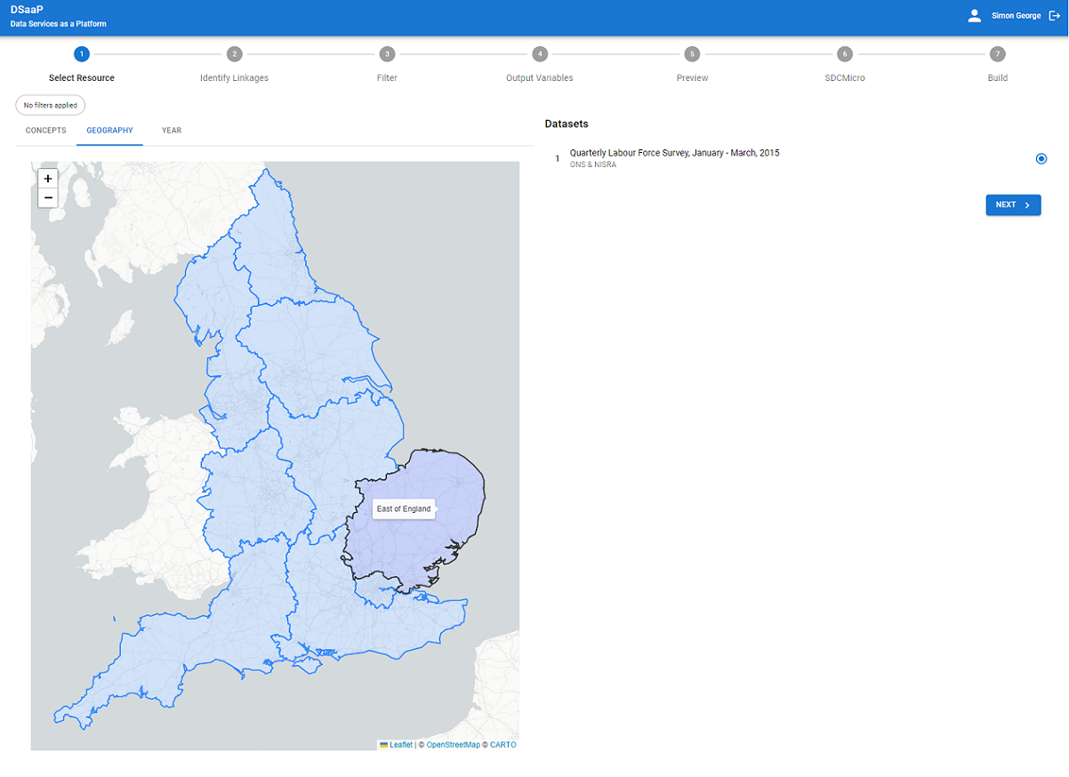
DPB – Dataset Selection (cont.)
Back

Slide 10
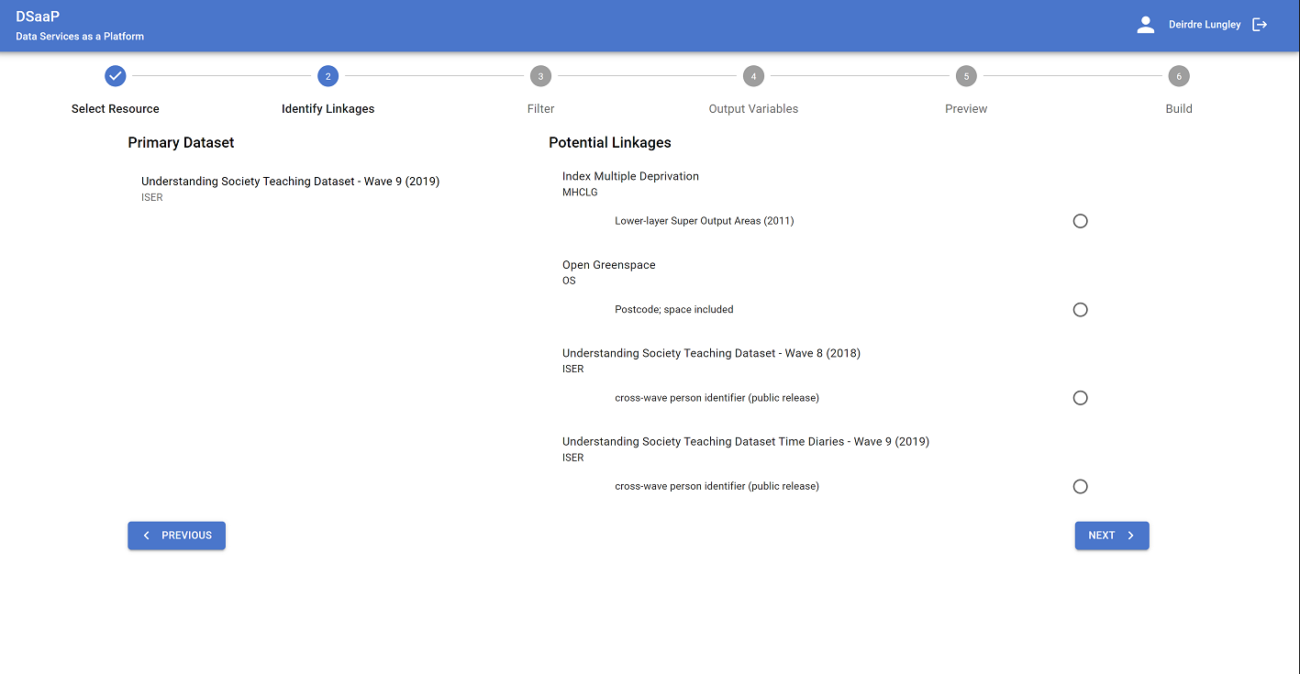
DPB – Select Linkage
Back

Slide 11
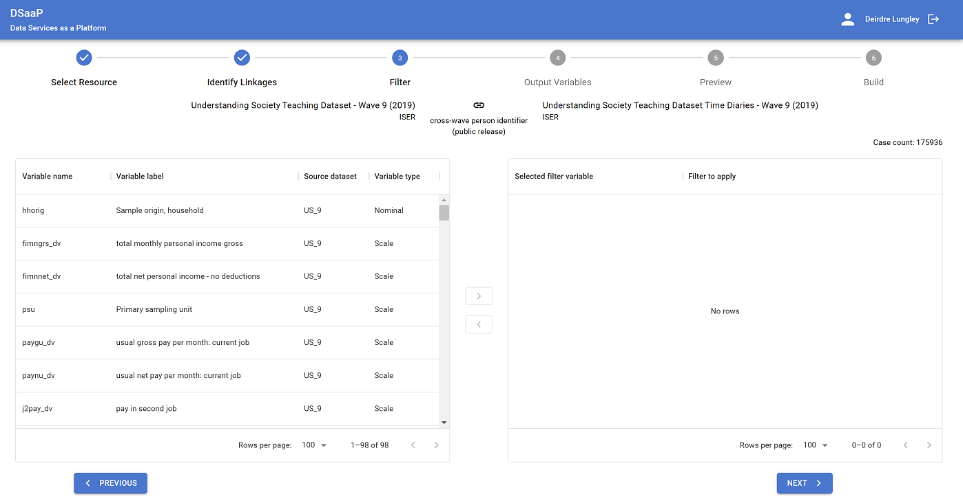
DPB - Filterable Variables
Back

Slide 12
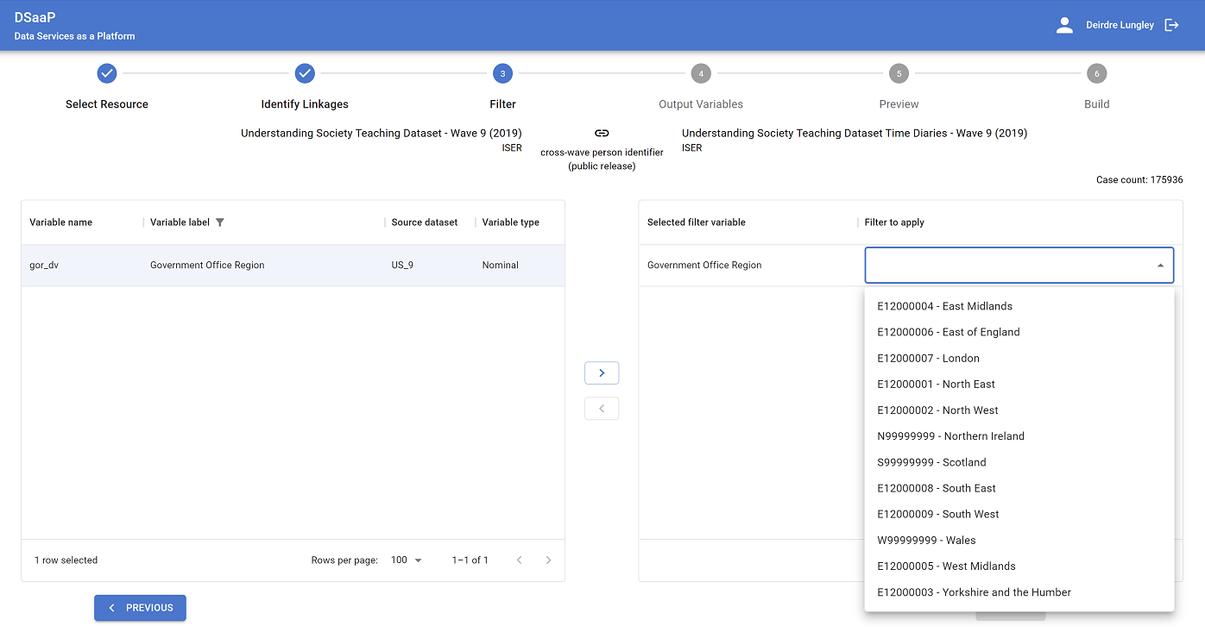
DPB – Filter Responses by Category Selection
Back

Slide 13
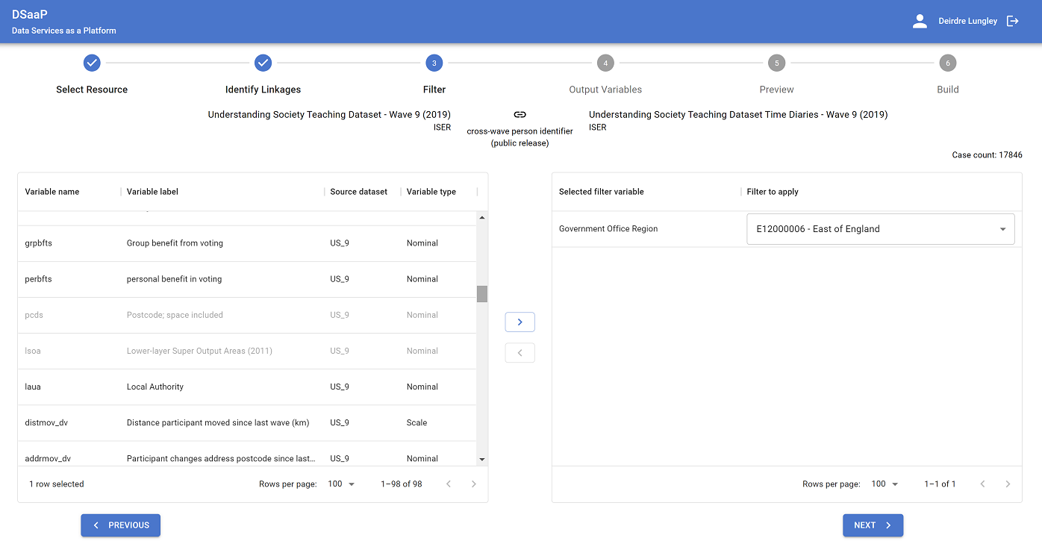
DPB – Sensitive Variables
Back

Slide 14
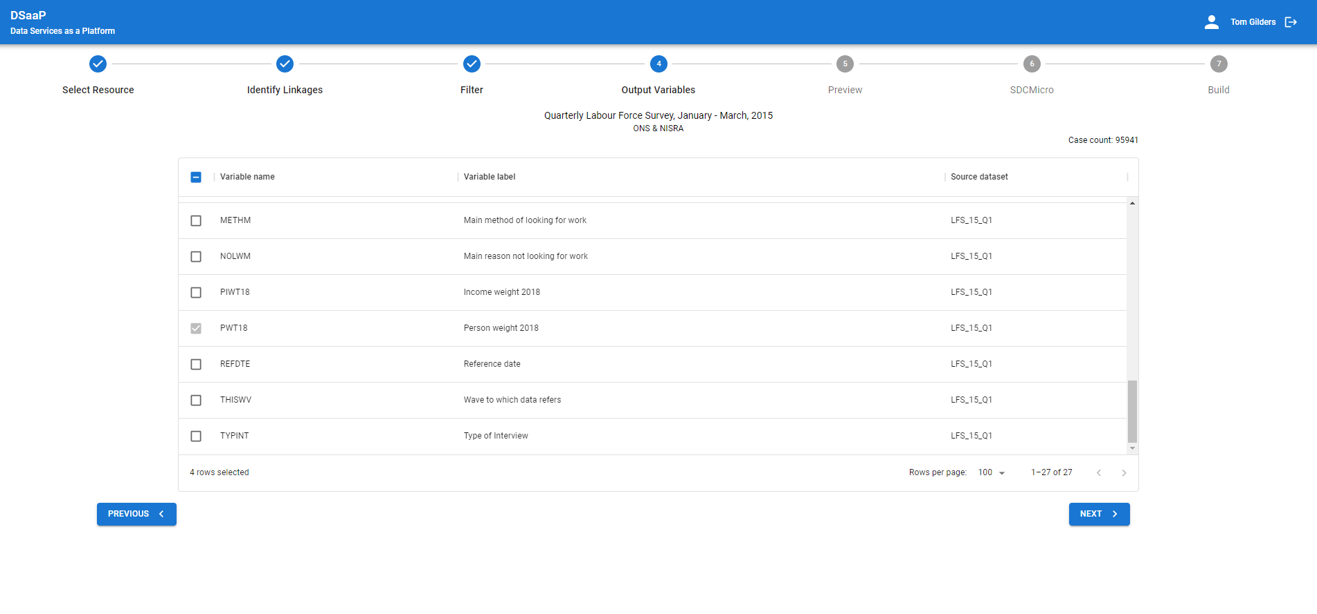
DPB – Weight Variable
Back

Slide 15
DPB – Disclosure Risk Analysis
DEMO
Back

Slide 16
Our Vision for Sensitive Interoperability
Break the current binary utility/risk trade-off of Secure Access or Open Access
Reduce the time to access data
Study metadata, enhanced with Data Privacy Vocabulary (DPV) concepts
Feed sdcMicro risk function which drive machine-assisted disclosure assessment
In turn feed a decision tree of real-time access outcomes
How?
Provide researchers with more flexible choices based on real-time mitigations of key variable sensitivity e.g. top/bottom recoding

Slide 17
Any questions?
?

Slide 18
Thank you.

